Slide 1

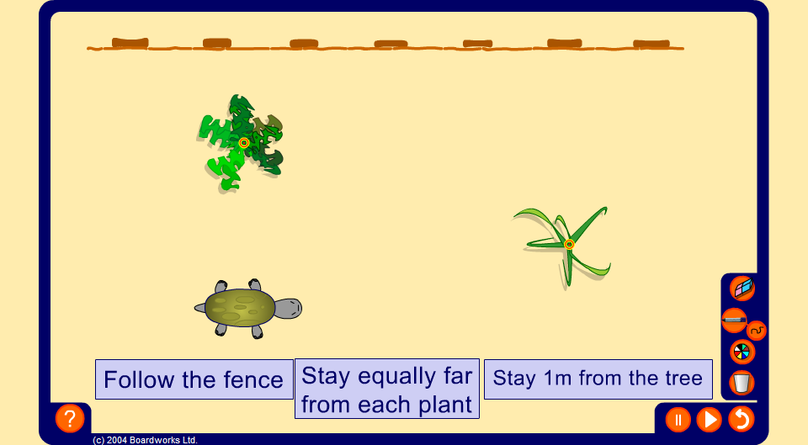


Walking turtle
Notes:
Introduce the locus of points that are a fixed distance from a point, the locus of points that are equidistant from two fixed points and the locus of points that are a fixed distance from a line by walking the turtle along each path.
Change the positions of the fence and the plants and ask a volunteer to come to the board and sketch a required path using the pen tool (set to draw straight lines if necessary). Animate the turtle and compare the paths.

